Slide 1
Ch02_Hardware and Software Concepts
Attendance System Change
https://www.quizn.show/quz/show/myShowMain.do

Slide 2
Contents
01_Introduction
02_Evolution of Hardware Devices
03_Hardware Components
04_Hardware Support for OS
05_Caching and Buffering
06_Software Overview
07_Application Programming Interfaces (APIs)
08_Compiling, Linking and Loading
09_Firmware
10_Middleware
Objectives - you should understand:
• hardware components that must be managed by an operating system.
• how hardware has evolved to support operating system functions.
• how to optimize performance of various hardware devices.
• the notion of an application programming interface (API).
• the process of compilation, linking and loading.

Slide 3
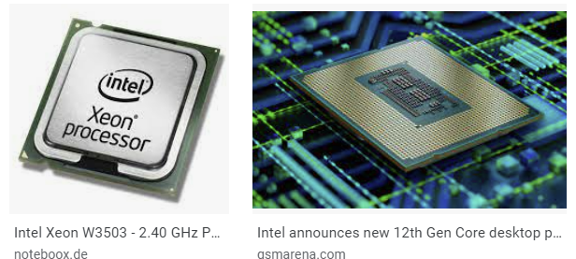
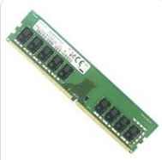
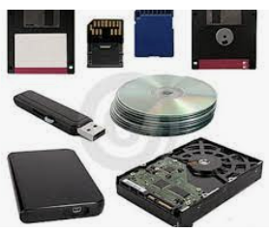
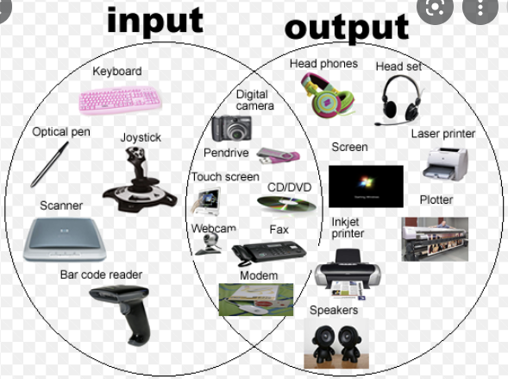
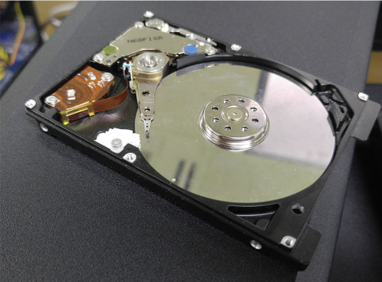
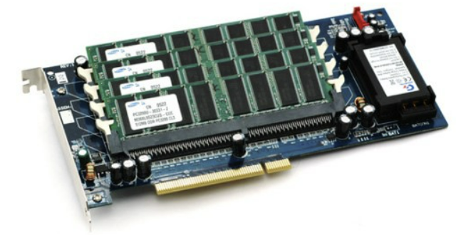
01_Introduction
Main role of the OS
Resource Manager
OS design is closely tied to the HW and SW management
HW & SW Resources
Processor
Memory
Secondary Storage
I/O Devices
Process
Thread
File
Database
HDD(Hard Disk Drive)
SSD(Solid State Drive)

Slide 4
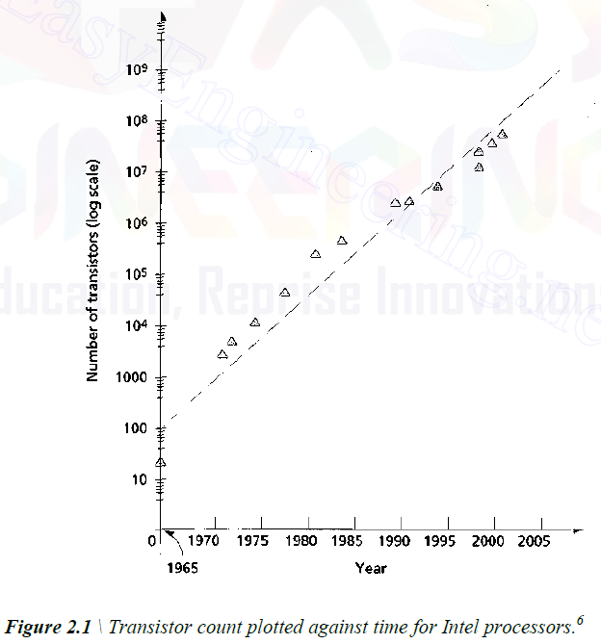
02_Evolution of HW devices
The number of transistors in processors is doubled roughly every year (Moore’s law)

Slide 5
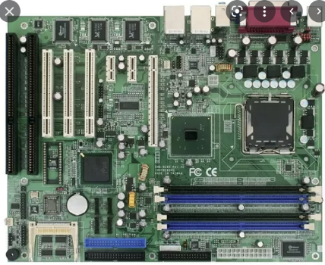
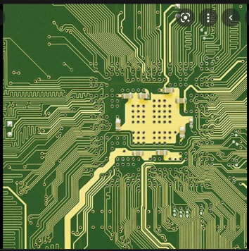
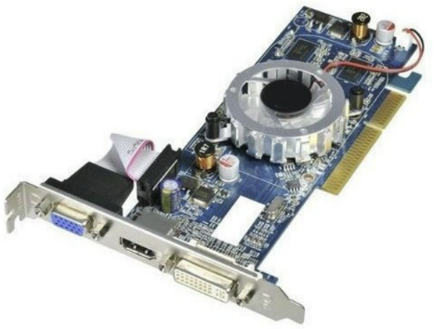
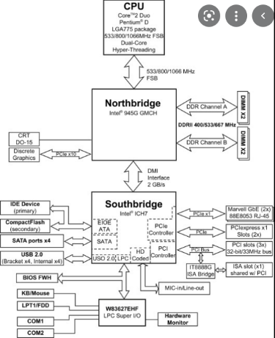
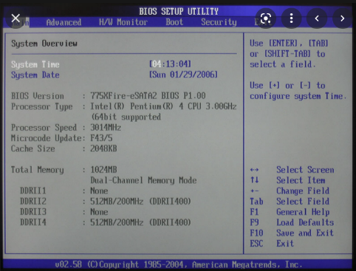
03_Hardware Components (1/10)
HW Components
Processor
Main Memory
I/O Devices
Mainboards (= Motherboards)
Printed Circuit Board(PCB)
Provides electrical connections between devices at various locations on the board
Mainboard - the central PCB in a system
Provides slots into which other components are inserted (such as the processor, main memory and other hardware devices)
Include several computer chips(ex, BIOS chip) to perform low-level operations
BIOS chip
stores instructions for basic hardware initialization
and management
responsible for loading the initial portion(a process
called bootstrapping) of the OS into memory

Slide 6
03_Hardware Components (2/10)
Processors
Executes a stream of machine-language instructions
Central Processing Unit(CPU) - executes the instructions of a program
Instruction Fetch Unit - loads instructions into instruction registers
Instruction Decode Unit - interprets the instruction and passes the corresponding input for the execution unit to perform the instruction
Arithmetic and Logic Unit(ALU) - performs basic arithmetic and logical operations, such as addition, multiplication and logical comparisons
Cache – High-speed memory that stores copies of data in main memory
Classification - L1 Cache, L2 Cache
Register - High-speed memories located on a processor
The data must be placed in registers before a processor can operate on it
Coprocessor - execute a limited set of special-purpose instructions
ex) a graphics coprocessor or digital signal processor(DSP)

Slide 7
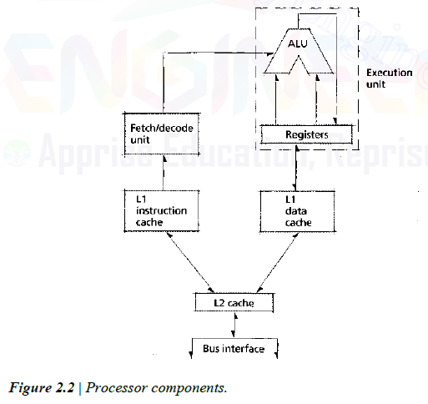
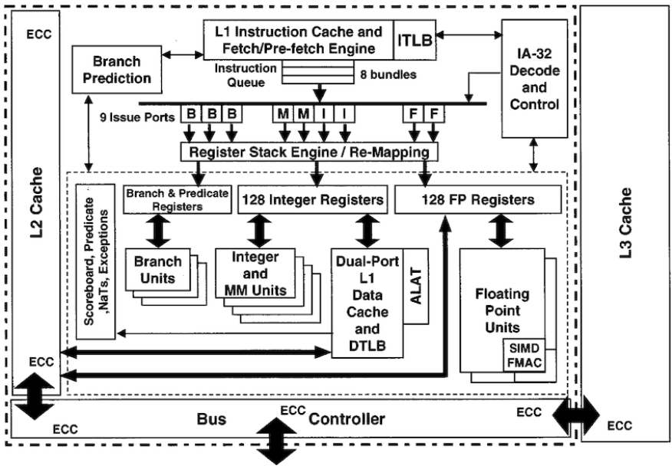
03_Hardware Components (3/10)
Processors(CONT)
Processor Components

Slide 8
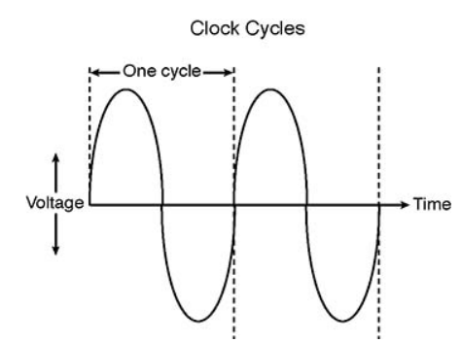
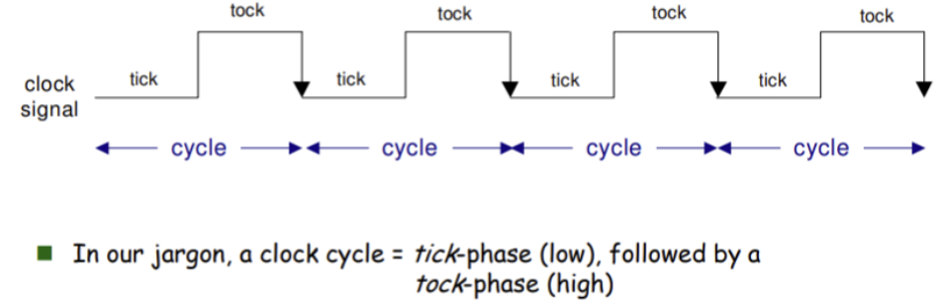
03_Hardware Components (4/10)
Clocks
Computer time is measured in cycles(clocktick)
Cycle - one complete oscillation of an electrical signal provided by the system clock generator
The clock generator determines the frequency at which buses transfer data
Cycles per second(Hz, hertz)

Slide 9
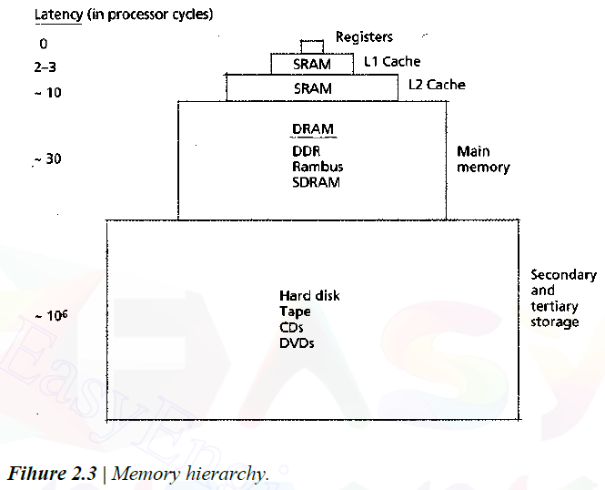
03_Hardware Components (5/10)
Memory Hierarchy
The fastest and most expensive memory is at the top and typically has a small capacity.
The slowest and least expensive memory is at the bottom and typically has a large capacity.
Volatile media- Data vanishes when they lose power
Register, Cache, Main Memory

Slide 10
03_Hardware Components (6/10)
Main Memory
Volatile Random Access Memory (RAM)
Processes can access data locations in any order
Type
Dynamic RAM(DRAM, Main Memory) – Requires a refresh circuit
Static RAM(SRAM, Cache) – Does not need a refresh circuit
Bandwidth – The amount of data that can be transferred per unit of time
Secondary Storage
Permanently store large quantities of data with less cost
Access to data is much slower than main memory
Requires mechanical movement of the read/write head
Rotational latency
Transfer time as the data passes by the head
Secondary storage devices facilitating data backup and data transfer
CDs(CD-R, CD-RW), DVDs(DVD-R), Zip Disks, Floppy Disks, Fresh Memory Cards, Tapes

Slide 11
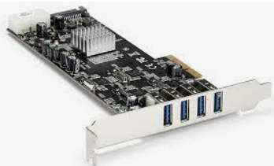
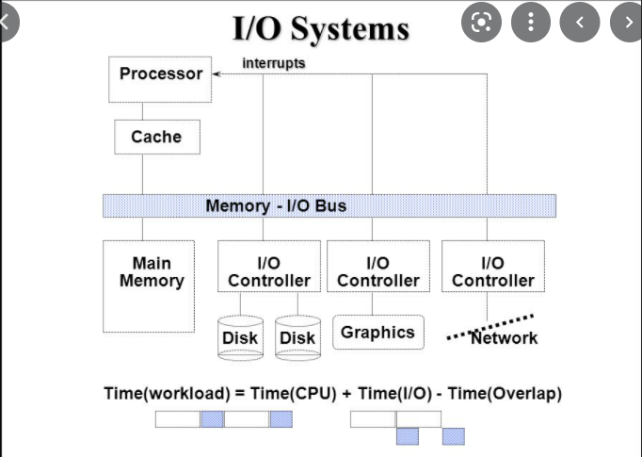
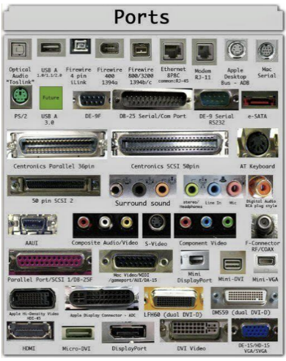
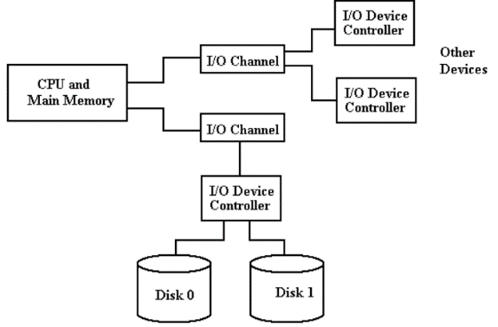
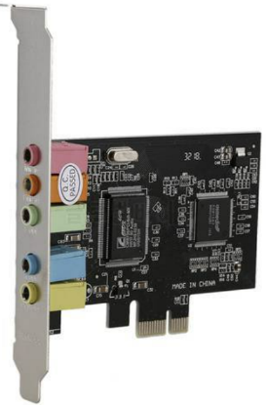
03_Hardware Components (7/10)
Buses
A collection of traces
Trace – An electrical connections that transport information between hardware devices
Data bus – transport data
Address Bus – determines the recipient or sources of data
Port – a bus that connects exactly two devices
I/O channel – A bus that several devices share to perform I/O operations
Front Side Bus (FSB) – Connects a processor to main memory
Double Date Rate (DDR) - Two memory transfers per clock cycle
Peripheral Component Interconnect (PCI) bus - Connects peripheral devices, such as sound cards and network cards, to the rest of the system

Slide 12
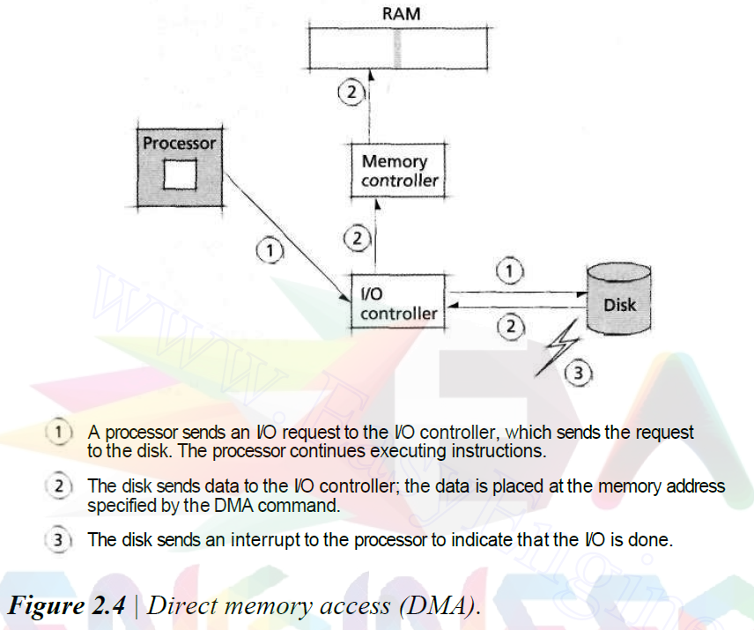


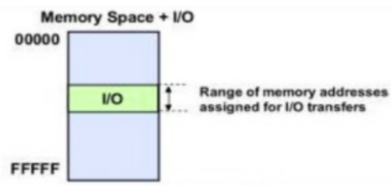
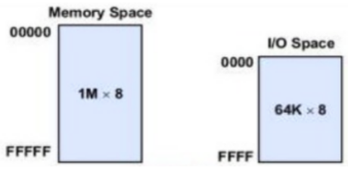
03_Hardware Components (8/10)
Programmed I/O(PIO) and Interrupt-driven I/O
PIO - Specifies a byte or word to be transferred between main memory and an I/O device – Memory Mapped I/O, I/O Mapped I/O
Interrupt-driven I/O - The I/O device notifies the processor when the operation was complete by generating an interrupt
Direct Memory Access (DMA)
Improves data transfer efficiency between memory and I/O devices
Enables devices and controllers to transfer blocks of data to and from main memory directly
Frees the processor to execute SW instructions
DMA channel uses an I/O controller to manage
data transfer between I/O devices and MM
The I/O controller generates an interrupt to
the processor when the operation is complete
Improves performance significantly in systems
that perform large numbers of I/O operations
(e.g. mainframes and servers)
Memory Mapped
I/O Mapped

Slide 13
03_Hardware Components (9/10)
Peripheral Devices (PD)
Hardware device that is not required for a computer to execute software instructions
I/O Device – Printer, Scanner, Keyboard and Mouse
Network Device – Network Interface Card and Modem
Storage Device – CD, DVD and Disk Drive
Internal PD(= Integrated PD) - located inside the computer case
Modem, Sound Card, Internal CD-ROM drive and Hard Disk
Character Device - Transfer data one character at a time
Keyboard & Mouse
Interface between Peripheral Devices and Computer
Serial Port – transfer data one bit at a time (connecting Keyboard, Mouse)
Parallel Port – transfer data several bits at a time (connecting Printer)
USB and IEEE1394 ports – Popular High-Speed Serial Interface
SCSI(Small Computer System Interface) – Popular Parallel Interface

Slide 14
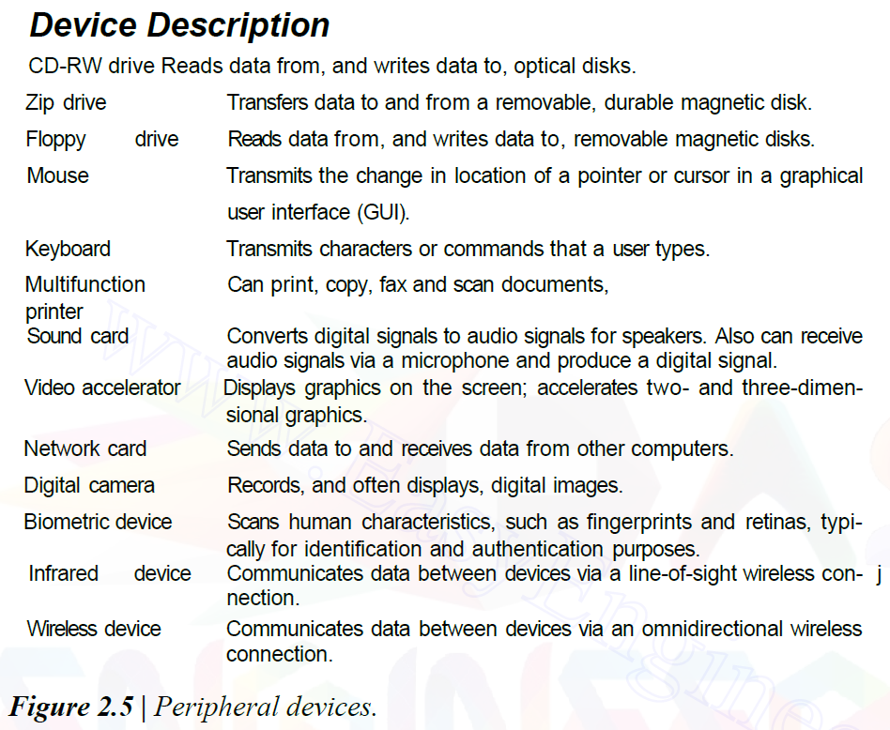
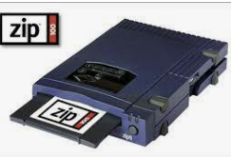
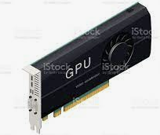

03_Hardware Components (10/10)
Peripheral Devices(CONT)

Slide 15
04_Hardware Support for OS (1/2)
Processor
Most operating systems rely on processors to implement their protection mechanisms
Preventing processes from accessing privileged instructions or memory that has not been allocated to them
Computer System Execution Modes
User Mode – Prevent the direct access of protected resources
Kernel Mode - Execute privileged instructions and access protected resources
Memory Protection and management
Prevents processes from accessing memory that has not been assigned to them
Implement using processor registers that can be modified only by privileged instructions (ex, bounds register)
Interrupts and Exceptions
Interrupts - A signal that devices send to the processor when an event occurs
Exceptions – A kind of interrupts generated in response to errors, such as hardware failures, logic errors and protection violations

Slide 16
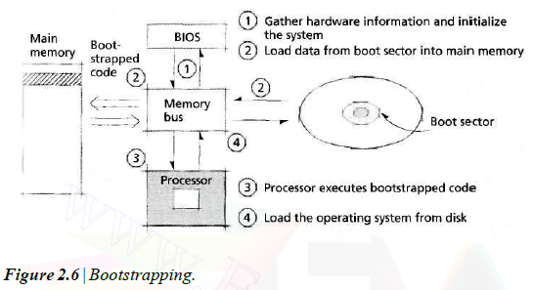
04_Hardware Support for OS (2/2)
Bootstrapping
Load OS components into main memory
Execution by BIOS(Basic I/O System)
Initializes the system hardware
Load instructions into main memory from a region of secondary storage called the boot sector
Initialize processor registers
Prepare the system to run user applications
If system does not load boot sector, the user is unable to access any of the computer’s HW

Slide 17
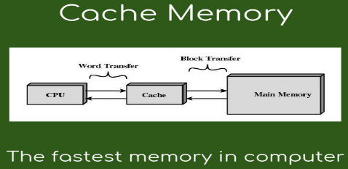
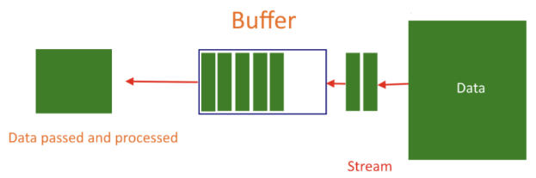
05_Caching and Buffering
Caching and Buffering
Cache
The high cost of fast storage
Cache hit – A referenced item is present in the cache
Cache miss – A referenced item is not present in the cache
Example of cache
L1 and L2 Processor caches
Systems allocate a portion of main memory to cache data from secondary storage
Buffer
Storage area that temporarily holds data during transfers between devices or processes that operate at different speeds
Improve system performance by allowing software and hardware devices to transmit data and requests asynchronously
Spooling
A technique in which an intermediate device, such as a disk, is interposed
between a process and a low-speed or buffer-limited I/O device
Device1
Device2

Slide 18
06_Software Overview (1/2)
Machine Language and Assembly Language
Machine Language - streams of numbers (1s and Os) that instruct computers how to perform their most elementary operations
Assembly Language - English-like abbreviations to represent the computer's basic operations
Interpreters and Compilers
Compiler - convert high-level language programs to machine language programs
Interpreter - programs which directly execute source code or code has been reduced to a low-level language that is not machine code
High-Level Languages
Language that look similar to everyday English and that contain common mathematical notations
Fortran(for scientific and engineering applications, 1950s), COBOL(for business applications, 1950s), C(development language of the UNIX OS, 1970s), C++(extension of C, capabilities for OOP, 1980s), Java(create applications that could be downloaded over the Web and executed in Web browsers, 1995), C#(designed specifically to be the key development language for the .NET platform, 2000)

Slide 19
06_Software Overview (2/2)
Structured Programming (= Modular Programming)
A disciplined approach to creating programs that are clear, correct and easy to modify
Pascal - Designed for teaching structured programming
Ada - The first languages designed to facilitate concurrent programming
Object-Oriented Programming
Object technology - A packaging scheme for creating meaningful software units
Objects - properties(also called attributes), such as color, size and weight; and they perform actions (also called behaviors or methods), such as moving, sleeping or drawing
Classes are types of related objects (ex, “car”class)
A class specifies the general format of its objects, and the properties and actions available to an object depend on its class
Improve SW reusability and production

Slide 20
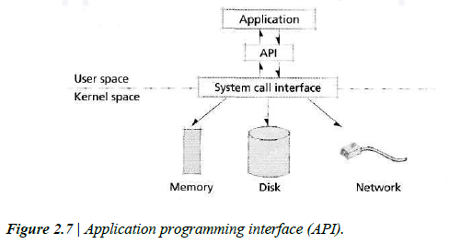
07_Application Programming Interface
API, Application Programming Interface
A set of routines that programmers can use to request services from the operating system
Communication between SW and the OS is performed exclusively through APIs
API Examples
POSIX(Portable OS Interface) Standards
Windows API

Slide 21
08_Compiling, Linking and Loading (1/7)
To execute a program written in a high-level language
Compiling - Translates into machine language
Linking - Links with various other machine-language programs on which it depends
Loading – Load into main memory

Slide 22
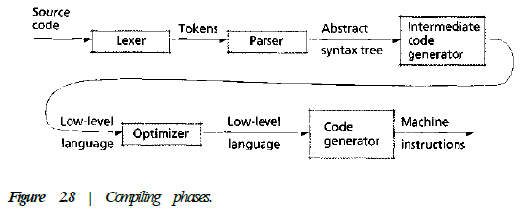
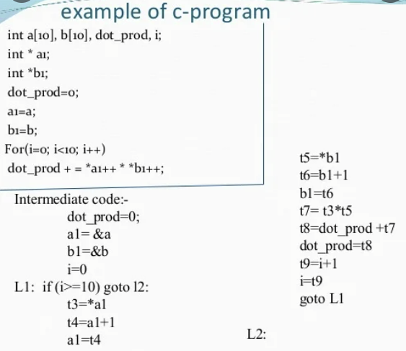
08_Compiling, Linking and Loading (2/7)
Compiling
Translating the high-level programming language code to machine language
Compiling Process
Lexer(Lexical Analyzer or Scanner)
Separates the characters of a program's source into tokens
Token: keywords(if, else, int), identifiers(named variables, constants), operators(-, +, *, /), punctuation( ; )
Parser(Syntax analyzer)
Groups the tokens into syntactically correct statements
Intermediate Code Generator
Converts syntactic structure into a stream of simple instructions
Optimizer
Improve the code's execution efficiency and reduce the program's memory requirements
Code Generator
Produces the object file containing the machine-language instructions

Slide 23
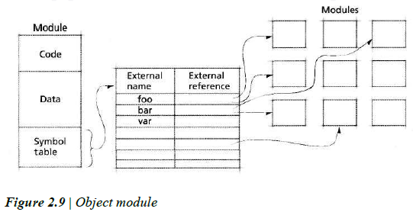
08_Compiling, Linking and Loading (3/7)
Linking
The process of integrating the various modules referenced by a program into a single executable unit
Program - Several independently developed subprograms, called modules.
Library - Precompiled modules as a common computer routines
Object Module

Slide 24
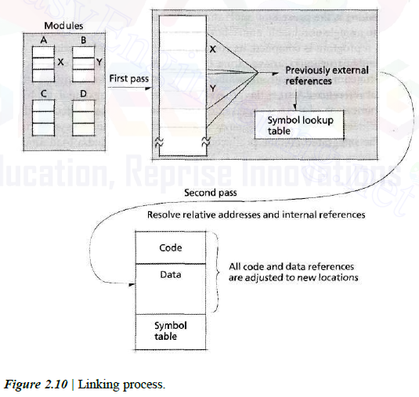
08_Compiling, Linking and Loading (4/7)
Linking(CONT)
Linking Process

Slide 25
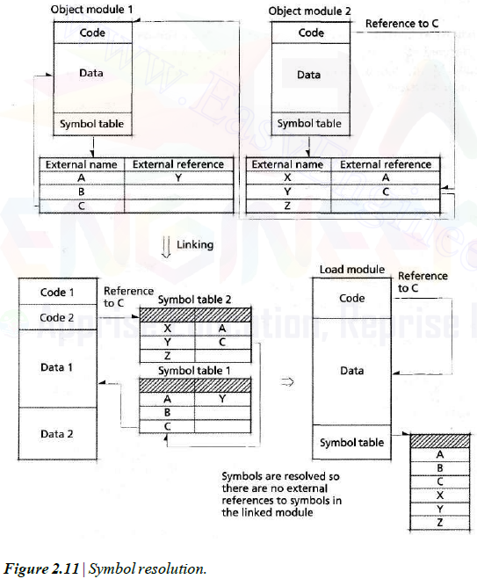
08_Compiling, Linking and Loading (5/7)
Linking(CONT)
Symbol Resolution

Slide 26
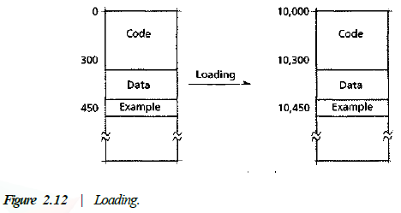
08_Compiling, Linking and Loading (6/7)
Loading
Loader
Placing each instruction and data unit at a particular main memory address
Absolute Loading
Places the instruction and data units at the addresses specified by the programmer or compiler
Relocatable loading
Performs when the load module contains relative addresses that need to be converted to actual memory addresses
Dynamic Loading
A technique that loads program modules upon first use

Slide 27
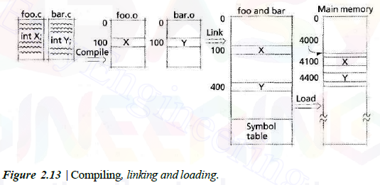
08_Compiling, Linking and Loading (7/7)
Compiling, Linking and Loading

Slide 28
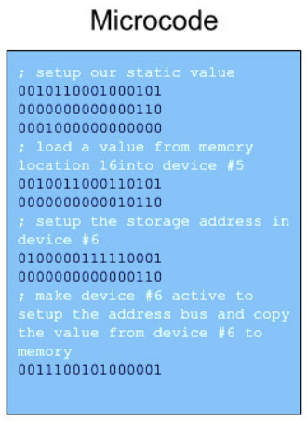
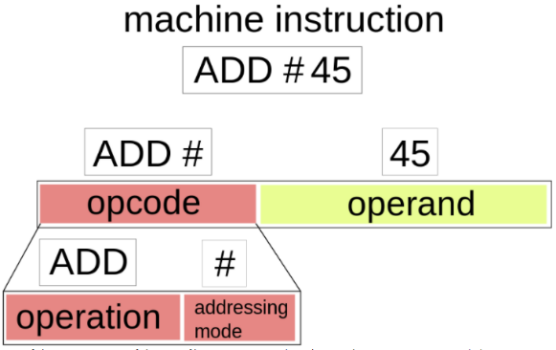
09_Firmware
Firmware
Executable instructions stored in persistent, often read-only memory attached to a device
Programmed with microprogramming
Microprogramming – A layer of programming below a computer's machine language

Slide 29
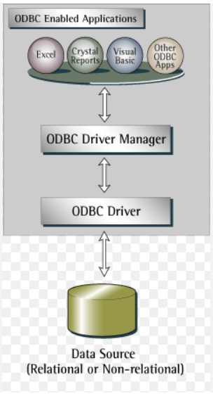
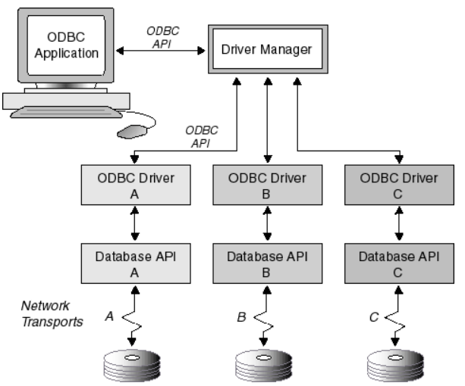
10_Middleware
Software for Distributed Systems (= Middleware)
Allows an application running on one computer to communicate with an application running on a remote computer (ex, TCP/IP)
Enabling communications between computers in distributed systems
ODBC - Open DataBase Connectivity
Applications access databases through middleware call an ODBC driver
ODBC driver handles connecting to the database and retrieving the information required by the application

